Slide 1



EDUBRIDGE AI
Frontend
Backend
Database
Kotlin
Java
Html
CSS
Email.js
Stabailty(API)
Groq(API)
Firestore
Local stoarge

Slide 2

Problem
TAM, SAM, SOM :-
TAM: Students needing better conceptual learning globally.
SAM: Learners in developing & low-resource environments.
SOM: Initial focus on schools with limited infrastructure (India).
Problem Statement:-
Students show marks but lack true understanding of concepts.
Teachers cannot identify exact misunderstanding types in large classes.
Existing systems measure performance, not real comprehension gaps.
Customer Segment :-
Students in low-resource and rural classrooms.
Teachers handling high student-teacher ratios.
Schools with limited internet and digital access.
Existing Solutions :-
E-learning platforms focus on content delivery, not comprehension detection.
Traditional teaching lacks personalized feedback for each student.
Most tools require continuous internet and high resources.
Competition :-
Video-learning apps (one-way learning, no gap detection).
Exam-focused coaching systems.
Basic adaptive tools with limited AI understanding of mistakes.

Slide 3
Solution
What is your Solution?
AI-powered system that detects real comprehension gaps from student responses (voice/text/quiz).
Provides personalized explanations using visuals, stories, and simple language.
Works offline-first for low-resource classrooms with minimal teacher interruption.
Parent-Friendly Monitoring: An automated email is sent to parents whenever the student leaves or closes the app, ensuring transparency and monitoring.
Economic Benefit to the Customer :-
Reduces dependency on expensive coaching and extra resources.
Saves teacher time through automated misconception detection.
Improves learning outcomes, leading to better academic performance.
.
What Makes Your Solution Unique?
Focuses on understanding (why wrong), not just marks or scores.
Generates AI-based visual storytelling explanations for clarity.
Designed for low internet + regional language support

Slide 4
Product
User Journey:
Student/teacher registers and selects language & learning level.
Access lessons, videos, and AI-based doubt solving.
Track progress, complete tasks, and get feedback.
Screens / System Design:
Simple UI: Login, Dashboard, Learning Module, Chatbot support.
AI engine provides personalized content and answers doubts.
Architecture: Mobile/Web App → AI Server → Cloud Database.
Constraints Handling:
Designed for low-cost devices and rural users.
Simple interface for easy understanding.
Scalable system to support many students.
4. How does it work with:
Low Internet : Offline access to downloaded lessons.
Low data usage with compressed content.
Low Literacy : Voice-based learning and visual content.
Regional language support.
No Infrastructure : Works on smartphones without needing schools or labs.
Can be used anywhere, anytime.

Slide 5
Startup Potential
Who will actually use this?
Students from rural and low-resource areas.
Teachers needing digital teaching support.
NGOs and schools focusing on inclusive education.
Why will they adopt it?
Easy to use with local language and simple interface.
Provides affordable and accessible quality education.
AI-based personalized learning improves understanding.
Can it scale? How?
Cloud-based platform can support large number of users.
Can expand to different regions with multiple languages.
Easily adaptable for schools, colleges, and training centers.
Revenue logic
Freemium model basic content free, advanced features paid.
Subscription plans for schools and institutions.
Partnerships with NGOs/government for funding and reach.

Slide 6
Social Economic Impact of the Product
What changes after your solution?
Detects real learning gaps in students, not just exam scores.
Provides personalized learning support even in low-resource areas.
Reduces dependency on teachers for continuous monitoring.
2. How will you measure it?
-% reduction: Up to 50% reduction in learning gaps through personalized AI support.
-Time saved: Saves 30–50% of teacher time in monitoring and evaluation.
-Cost saved : Reduces education costs by minimizing need for private tuition.
Impact Level: Local / City / National
Helps individual classrooms at local level.
Can be adopted by schools across cities and states.
Scales nationally for government and education programs.
4. Long-term Vision: - What happens if this scales?
Every student gets personalized learning support.
Strong foundation learning across all regions.
Reduces education inequality and improves national literacy.

Slide 7
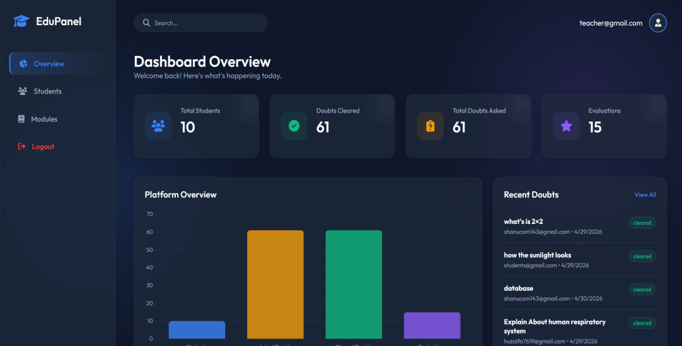
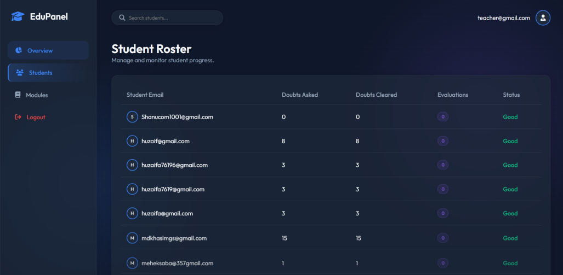
Team SHADOW NETWORK
Teacher Dashboard
DASHBOARD OVERVIEW
STUDENT ROASTER

Slide 8
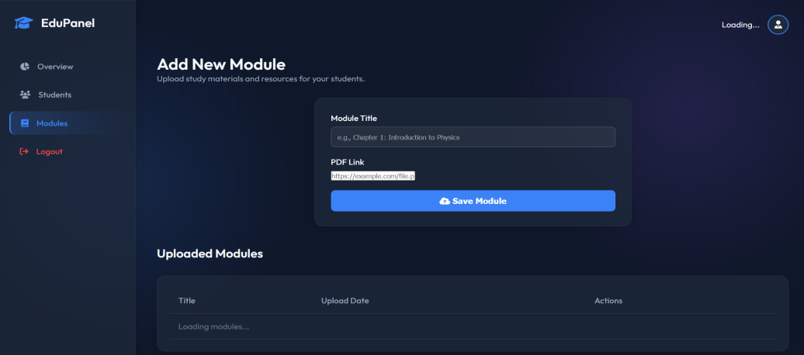
Team SHADOW NETWORK
ADDING NEW MODULES

Slide 9
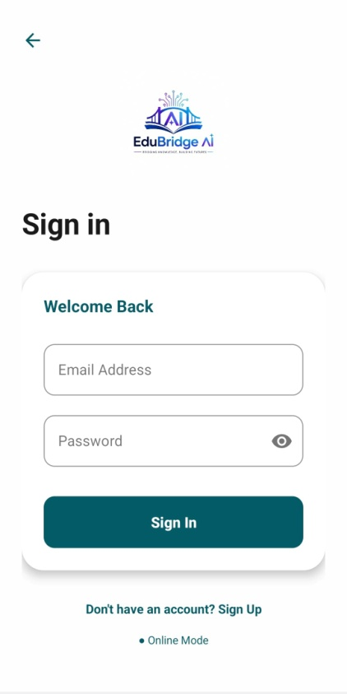
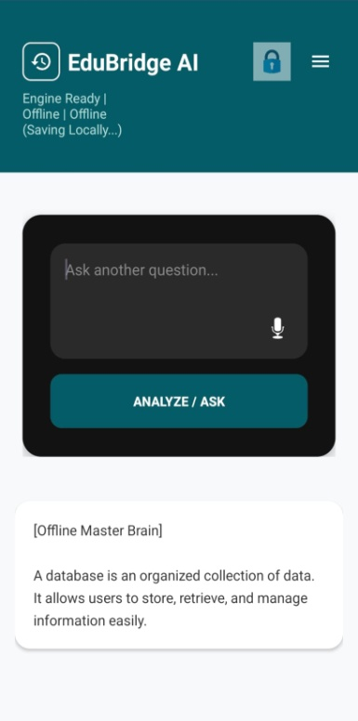
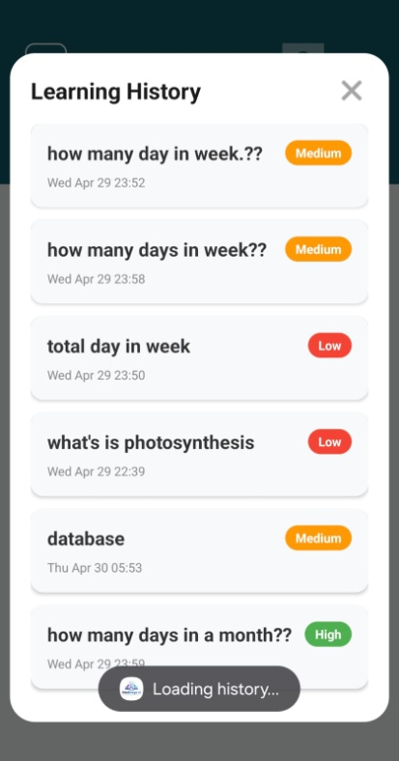
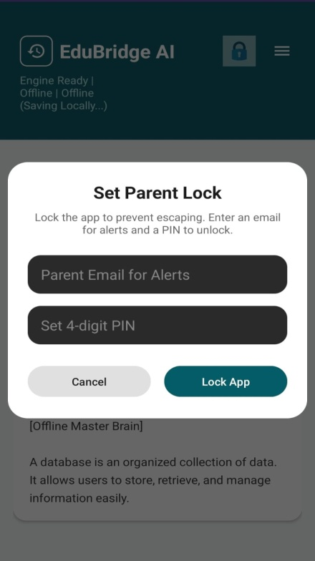
Team SHADOW NETWORK
STUDENT PANEL

Slide 10
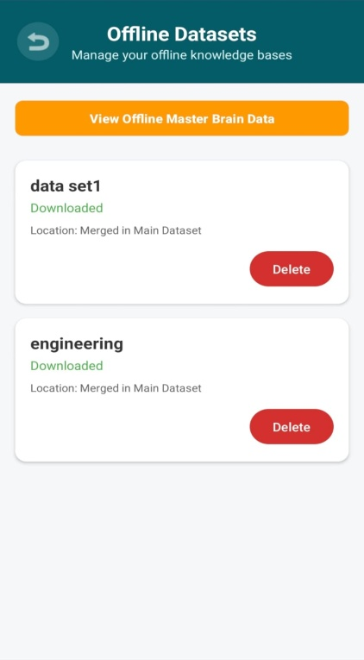
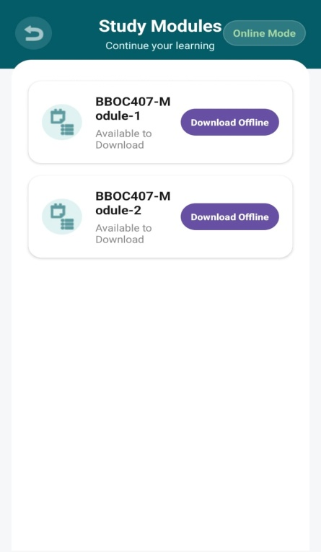
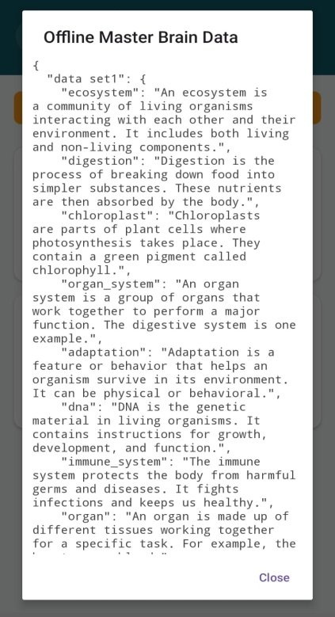
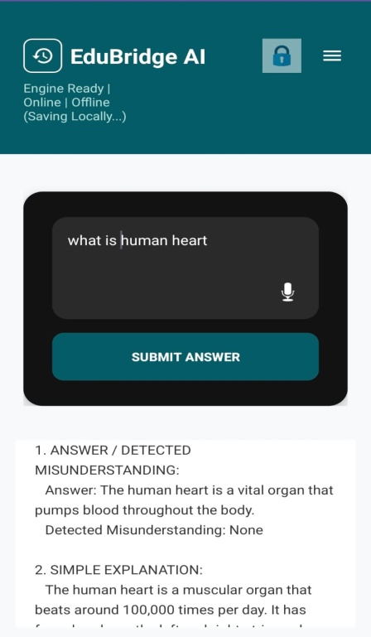
Team SHADOW NETWORK
STUDENT PANEL

